Slide 1

COURSE
NOTES:
DATA SCIENCE
WRAP-UP

Slide 2


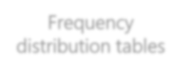



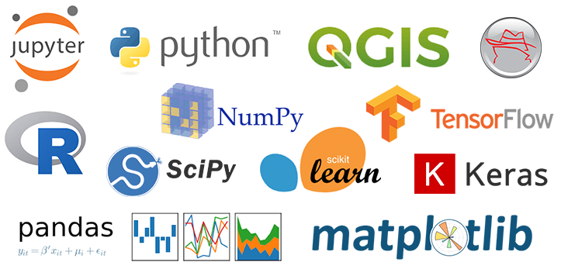
The Data Science Process
01
Understand
and define the problem
02
Collecting the
data
03
Exploring the
data
04
Modeling the
data
05
Interpreting the
data

Slide 3
The Role of ChatGPT and Like Models
Took the tech world by storm in 2022.
Understand and Generate Text.
Addition of Data Analysis Tool.
Upload data files.
Perform Data Analysis.
Limited Access.

Slide 4
The Role of ChatGPT and Like Models
Gemini.
Copilot.
Devin.
Perplexity.ai
Julius.
Visily.
Limitations in free plans.

